Slide 1
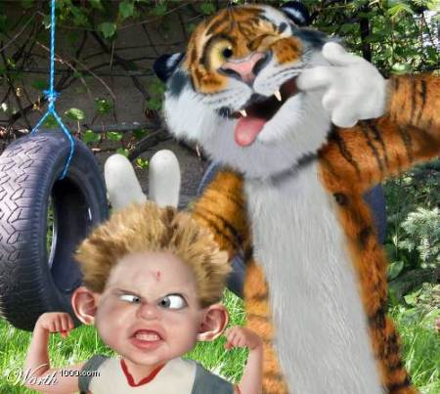
Voices in the Darkness: A Crash Course in Lifetime Learning
Audience members will be encouraged to use a childlike sense of wonder to voyage into the unknown and find their own voice.
Themes of fun, curiosity, imagination, and risk-taking will be explored.
This presentation utilizes educational music videos contextualized with speech.

